Slide 1
Table of Authorities
FBI
partner
development
DEA(Methamphetamine)
CPVA.ORCHESTRA
G.MAINSTRETET(HOMICIDE:KRYSTAL)
G(CHECKPOINT CHARLIE(anglea).HOMICIDE:LUX:CPVA Olympics
FORT WORTH LIBRARY (Messages)
FORT WORTH LIBRARY (Messages)

Slide 2
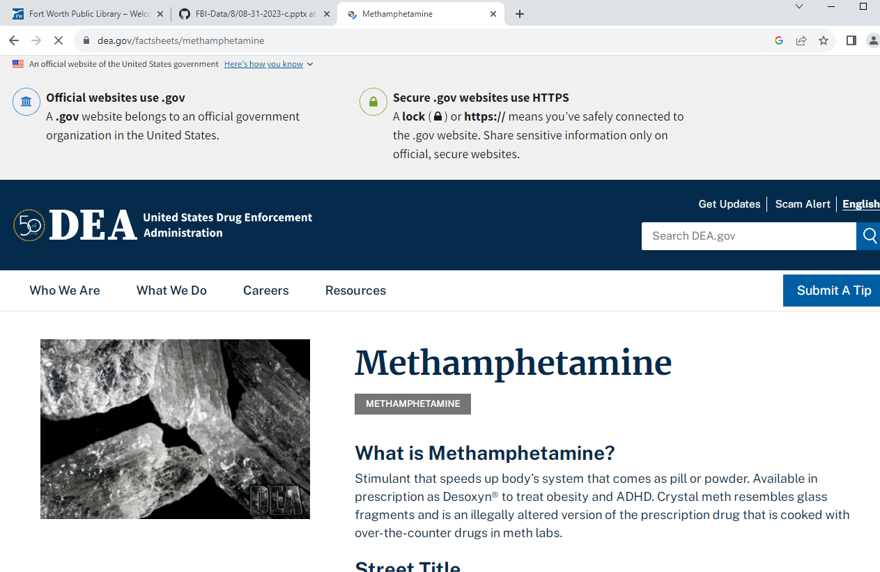
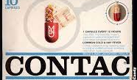
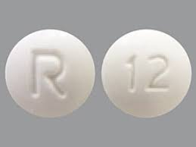
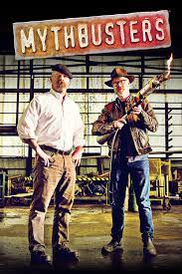
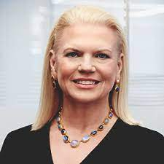
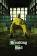
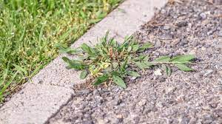

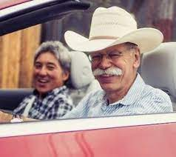
DEA(Methamphetamine)
FBI
partner
development
VIRIGIA
CHECKPOINT CHARLIE
1991 HOMICIDE:KYRSTAL
1996/7
SQ.CDCR(Charles).PREA
1991
2000/1
usage
SQ.WWI.apple.davidon.berney(krodile,unterhaus).danile)
VP GERAMNY.NAMCE HCNE(free pziee oli; kahn).
CHINA
2000/1 WAR /Haendelstrasse
HOMICDKE:LUX:St. Nick(Sap,Waldorf):HATEHOLE(hassloch)
$1.21 Gas
Available in prescription as Desoxyn®
DL-CA: Arco, Haward, Medicne Row
WWI.nonPoliceAresstXML.linsit(tootsie)
ATOMBUNKER(HOMICDIE:KRYTAL,ATOMBOMPOSTDR(JFK,werner)
IPX 2000/1 Stepanie
ATOMBUNKER(HOMICDIE:KRYTAL,ATOMBOMPOSTDR(JFK)
POLCIE SIRENS: 6:06PM
POLICE SIRENS: 5:16PM
!ddr.kahn
!HOMCIDE:NANA:WEEDS.NAME CHANGE((dleat) free pizze; 0.1 pick the weeds)
Chrystal, America, Jenny,
!HOMCE:KRSTAL:VIRIGIAN x/y[] 000.tw.pns

Slide 3
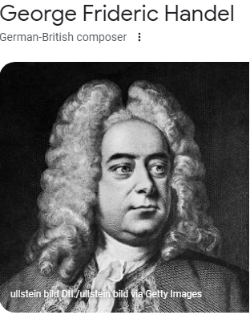
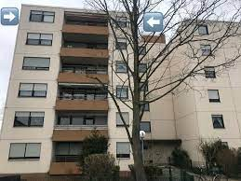
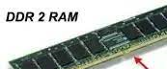
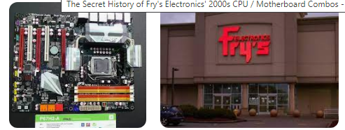
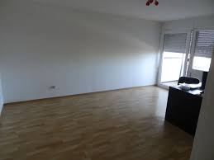
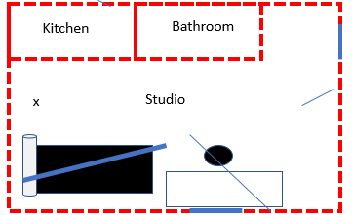
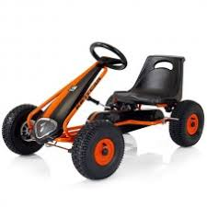
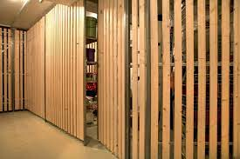
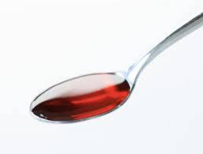
CPVA.ORCHESTRA
FBI
partner
development
Dec
MAINSTREEET
1997 – 1998
Haendelstrase
1998-1999 Hebelstrasse SYMPHONY
ORCHESTRA
1999 - 2000 SALES: JFK(WAR CHECKPCALREI (kdwe; hertie),Abitur))
2000 - 2001 Haendelstrase St. Nick:HOCME:LUX:HATEHOLE(sap/waldorf)
18-25
Ddr spy cherrytree fiat punto
2002-2003 Heinrich-Ditman-Kolleg
2003-2004 HOMICE:LUX:COINTOWN
St. Nick
CVPA.JFK(jacklin, ddr ram)
FBI:WMD: ddr inforin ram; “Blinki lights”; mediaplex
3) Stepahna and Ricardo we should atar a business
Kitchen
Bathroom
Arton Uka and freind §!Theft Lapotop; §AggAssult Maement ; calutes with letters
can you bring and apple computer? instead
x
Studio
2) Daniel welding logical room architect for library books
JFK(Abitur)
BSc. Wirtschaftsinfomatik
TERMIANOTR JOEPHE
Ipx Kettcar
CHECKPONT CALER PAUL: keller
IPX (DEA(herion, basement)
IMPORT uhaul,publistorage.apple
HOMCE KYSTAL:.toosie

Slide 4
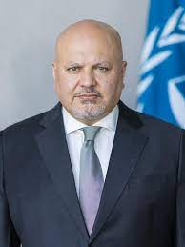
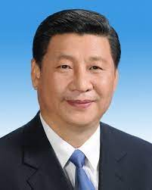
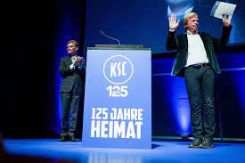
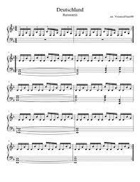
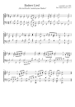
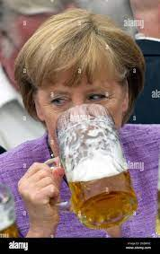

G.MAINSTRETET(HOMICIDE:KRYSTAL)
FBI
partner
development
SQ.AIRFILED.VIRINGA.MARY
Philpsburg
MAINSTREET
1998
nonPOliceStadim
MATHEW
WW2
ATOMCLOIC(Tim,roger)
Atomic Factory
(JFK)
badner lied noten ksc
phil/kim
JFK(0.Arabella)
- invitation
G
Werner, sascha
IMPORT St. Anselmo Marin City Coldwell 2006 Donehoue Street “View” !SQ.CDCR(jim)
j5
Sitzenpinlein (tnral) pissing in seating
!THANKGIVING
Snakeman, brading toung tattoo face
FORT WORTH LIBRARY
Werner, Sasche
x
Werner[]
Police Sirens: 5:55PM
SALE: Monpoloy
Visa IPS Course – Aliment of Power
Slide
STANFORD
HOMICDIE:COINTOWN

Slide 5
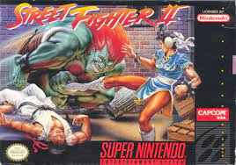
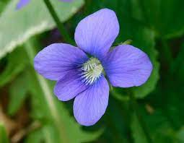
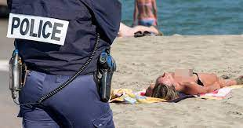
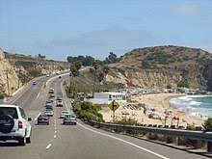
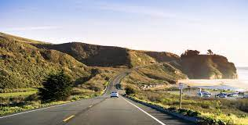
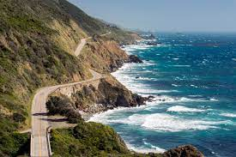
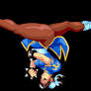
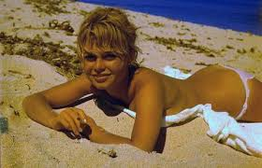
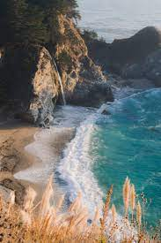
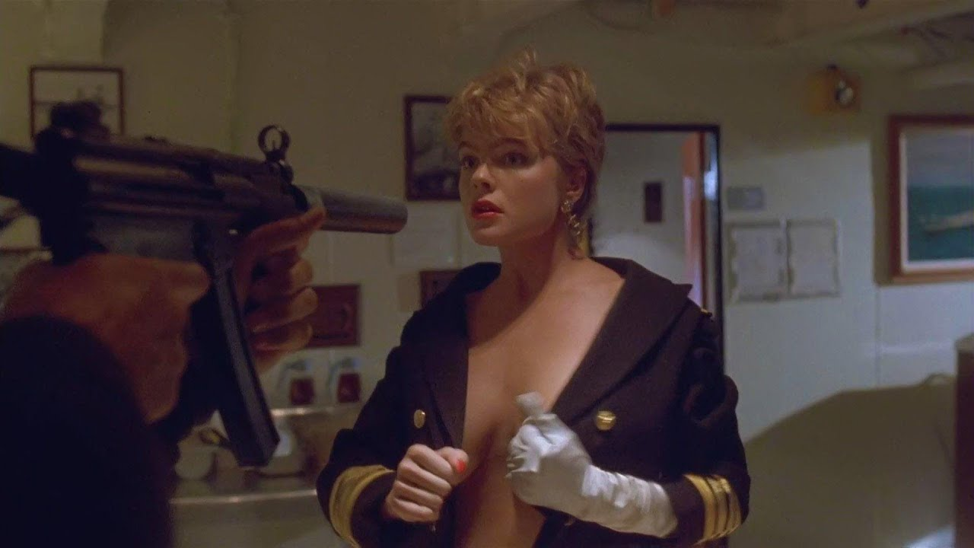

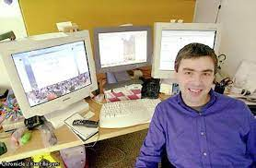
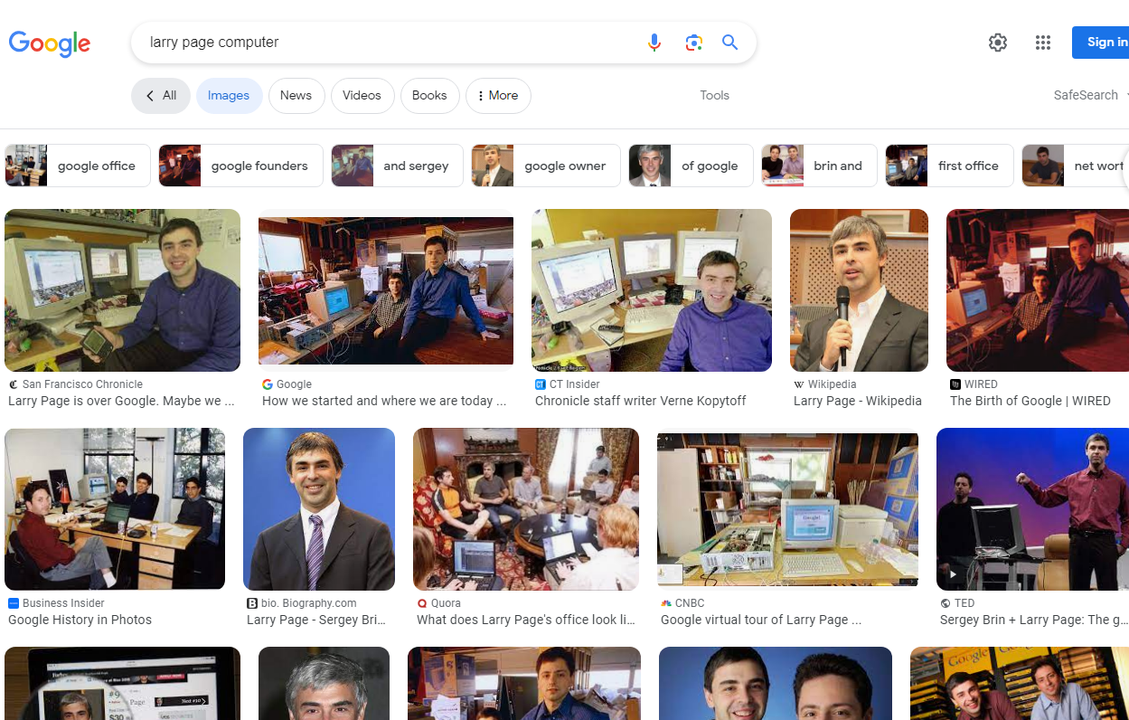
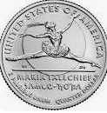
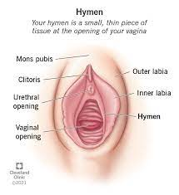
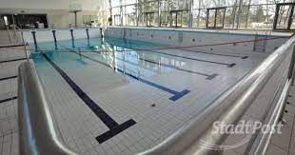
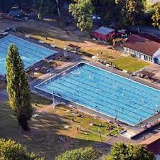
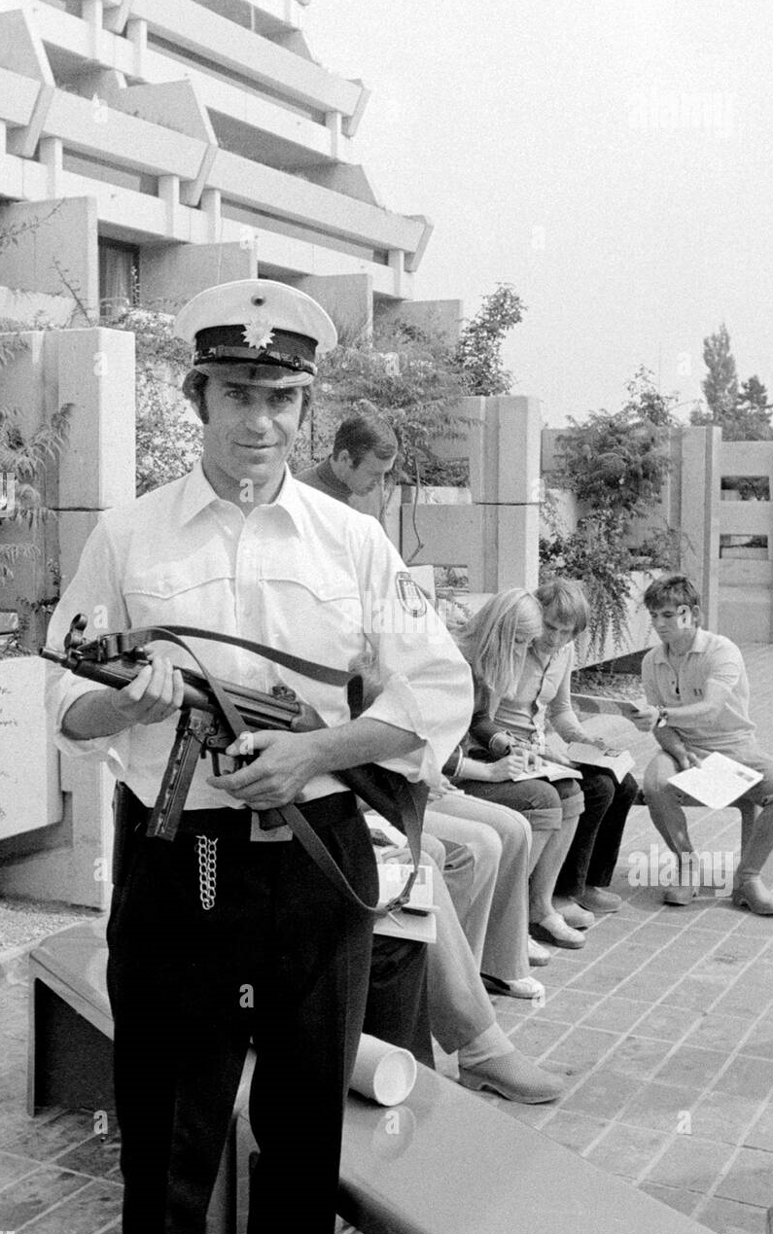
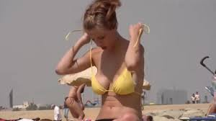
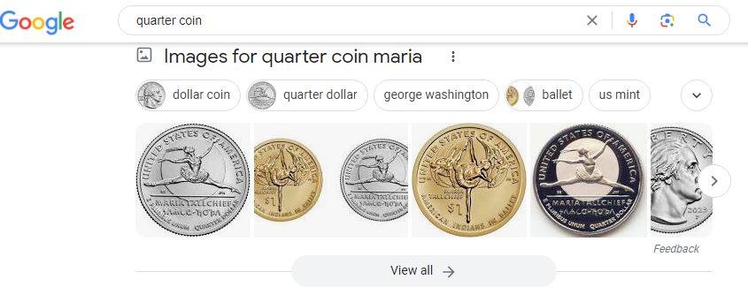

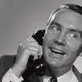
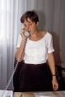
G(CHECKPON CHARLIE(anglea).HOMCIDE:LUX:CPVA Olympics
FBI
partner
development
ATOMPHYSICS
1991
HOMICDIE:LUX
Otto-Hann-Strasse
Missuouri
ATB Califonria
Backup: France
topless
PENTONG:PX:VHS:UNDER SIEGE
!HOCMEI:JEUSE:CHERIS:♥LACE
0.1 ATB
!Viola
Elke
Viola
Auschwitz
Gov. Swch(twis wolfgang:woflgan)
twisn: viola vioal
Gorbahce(Visa, France)
Google+
2010 My Grander has appremtns in missuroi

Slide 6
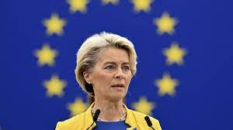
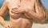
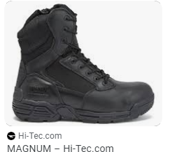
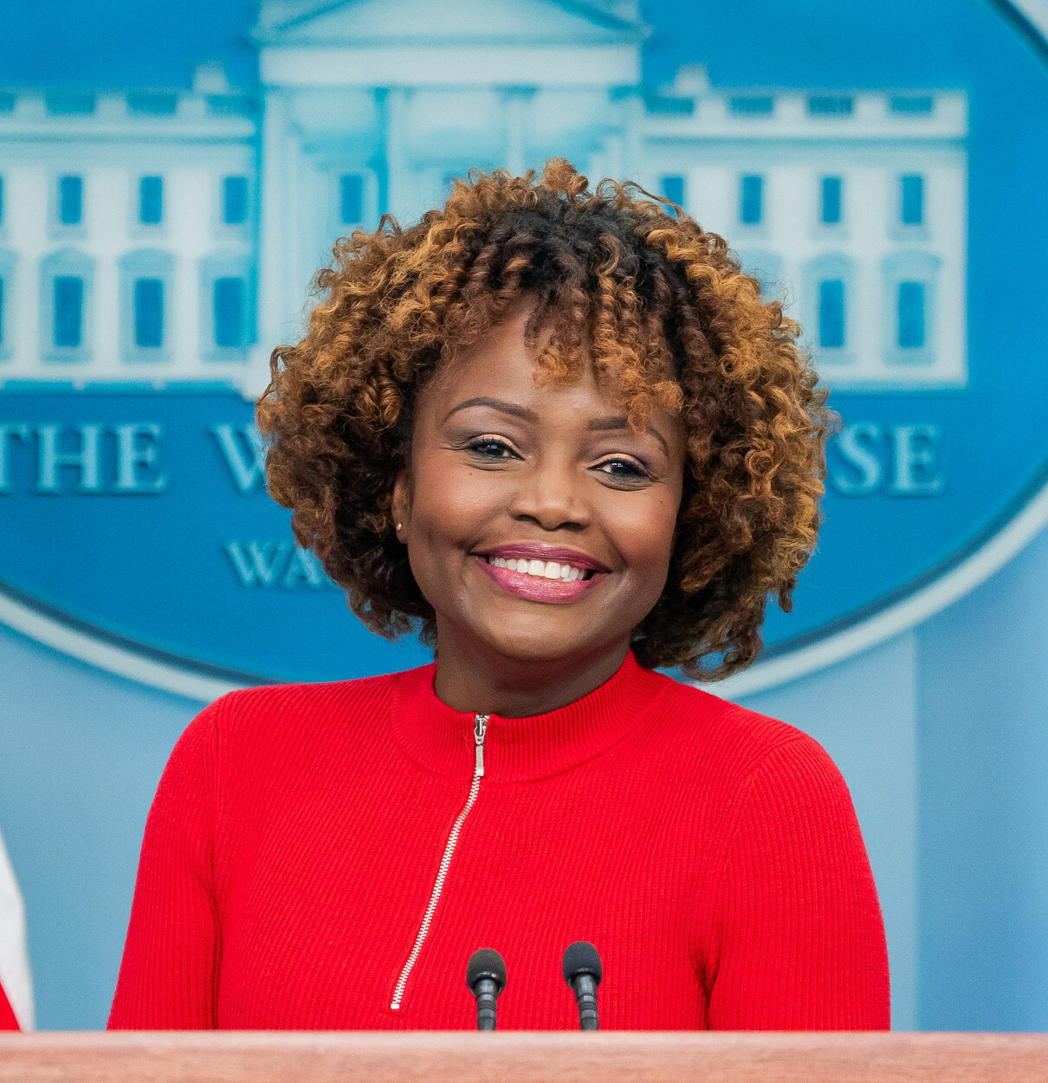

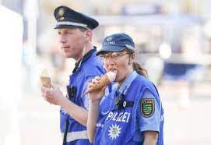
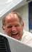








FORT WORTH LIBRARY (Messages)
FBI
partner
development
WWI:!HOMCIDE:KYSTAL
SUSPECT: HOMCE:LUX:Gov. Schw(twins.majsski)
HOMC:MAYOR: cristo flores gagneau
Roth.damiler.ibm.bertelsman.aravato.(magnum) andereas HOMCIDE:JEUS
E(dr,Zimmerman; j2ee)HAMBURG
IPX
WWI.marx(tootise)
VIRIGNA.MARY
SQ.INT.HOMICIDE:KYRSTAL slanted driveway , haflway house; cused by damiler
“Valley View”
Police Sirences: 6:56PM
JOEL
SQ.INT.1/4(RUSSIA).EUROPE.(INT).WAR R.A.F
Avg.1.4.marx(Street Crime Fighitng)
Joes and Isabell; luck stricke; HOMCE:IS-A-Bell(soviet union)

Slide 7




FORT WORTH LIBRARY (Messages)
FBI
partner
development
Gorbachev(phfelps,JFKsubway)
G.LARRY.(pole).ATOMCLOCK(0.1 Garage, Behind Capenter Door and pole)
FORT WORTH
Subway moved away next to court
SQ.INT.HOMICIDE:KYRSTAL slanted driveway , haflway house; cused by damiler
Police Sirences: 6:56PM
JOEL
SQ.INT.1/4(RUSSIA).EUROPE.(INT).WAR R.A.F
Avg.1.4.marx(Street Crime Fighitng)
Joes and Isabell; luck stricke; HOMCE:IS-A-Bell(soviet union)

Slide 8
0.1 MAINSTREET(UN.EU)
FBI
partner
development
G.MAINSTRETET(HOMICIDE:KRYSTAL)
[x] no
G.MAINSTRETET(1/4.marx(putin)
[x] !no

Slide 9






§Newspaper
FBI
partner
development
SALES:
1997 August Interview
1998 Septbmber HR Introduction
1994 !HOMICDE:BUNNY
Human
Resources
2003
2010 !HOMCE:DOG
§Theft
HOMCIDE:CAT
Ipx dell.quest.r-a-f
Bruchschen Sr.
2009 Phil/kim von dem bushe
Welt am sontagg
Reflection
HOMCIDE:ur_ur_omi(gheoh(dell.quest.Weltbild)
CPVA ORCHESTRA
DEA(Methamphetamine)
CPVA.ORCHESTRA
G.MAINSTRETET(HOMICIDE:KRYSTAL)
G(CHECKPOINT CHARLIE(anglea).HOMICIDE:LUX:CPVA Olympics
FORT WORTH LIBRARY (Messages)
FORT WORTH LIBRARY (Messages)
Stephone(x/y): Snow 3am Bicylce Fall
Stepnanie(x/y) Wake up 5am HOMCE:ur_ur_omi Bruchshcen
G.MAINSTRETET
(HOMICIDE:KRYSTAL)

Slide 10






§DEA
FBI
partner
development
Eisberg
IPX NAME CHANGE(free pizza, VP GERMANY oliver KAHN; )
Appel dnaiel kotje shows pullow from !PX us shop ATOMPOSTDR(werder)
IPX
blond eybrow with black stain

